Slide 1

Azure DevOps YAML
www.corvit.com

Slide 2
Topics
Yaml file hierarchy for Azure DevOps Pipeline
Creating First Pipeline
Changing Pipeline Name
Editing Pipeline
Running Pipeline
Creating Variable Group
Attaching Variable Group to Pipeline
Famous Expressions in Azure DevOps Yaml
www.corvit.com

Slide 3
Link for Azure DevOps YAML Configurations
https://learn.microsoft.com/en-us/azure/devops/pipelines/yaml-schema/?view=azure-pipelines
www.corvit.com

Slide 4
YAML File Hierarchy For Azure DevOps Pipeline
A pipeline is one or more stages that describe a CI/CD process. Stages are the major divisions in a pipeline. The stages "Build this app," "Run these tests," and "Deploy to preproduction" are good examples.
A stage is one or more jobs, which are units of work assignable to the same machine. You can arrange both stages and jobs into dependency graphs. Examples include "Run this stage before that one" and "This job depends on the output of that job."
A job is a linear series of steps. Steps can be tasks, scripts, or references to external templates.
Simple pipelines don't require all of these levels. For example, in a single-job build, you can omit the containers for stages and jobs because there are only steps.
www.corvit.com

Slide 5
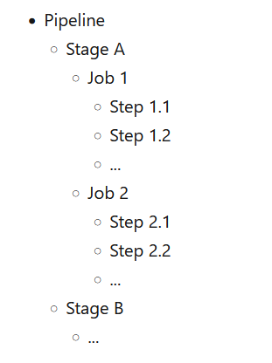
YAML file hierarchy for Azure DevOps Pipeline
This hierarchy is reflected in the structure of a YAML file like:
www.corvit.com

Slide 6
Creating First Pipeline
www.corvit.com

Slide 7
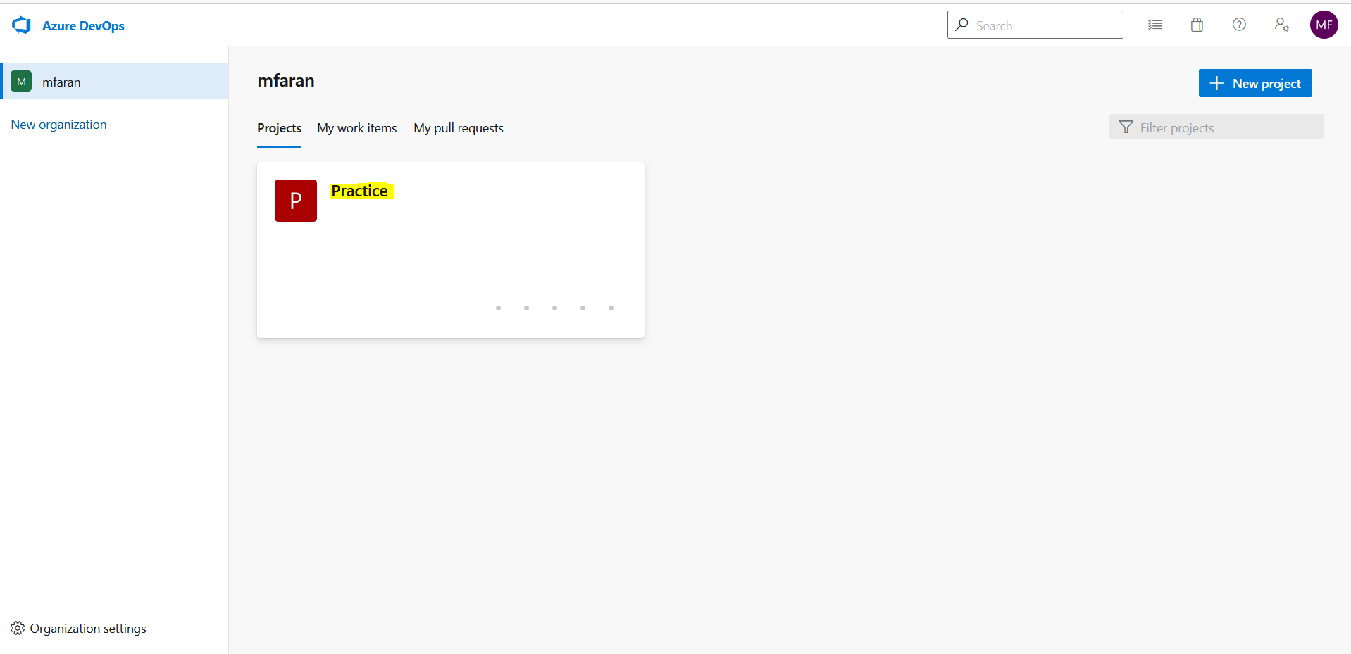
Select Organization
www.corvit.com

Slide 8
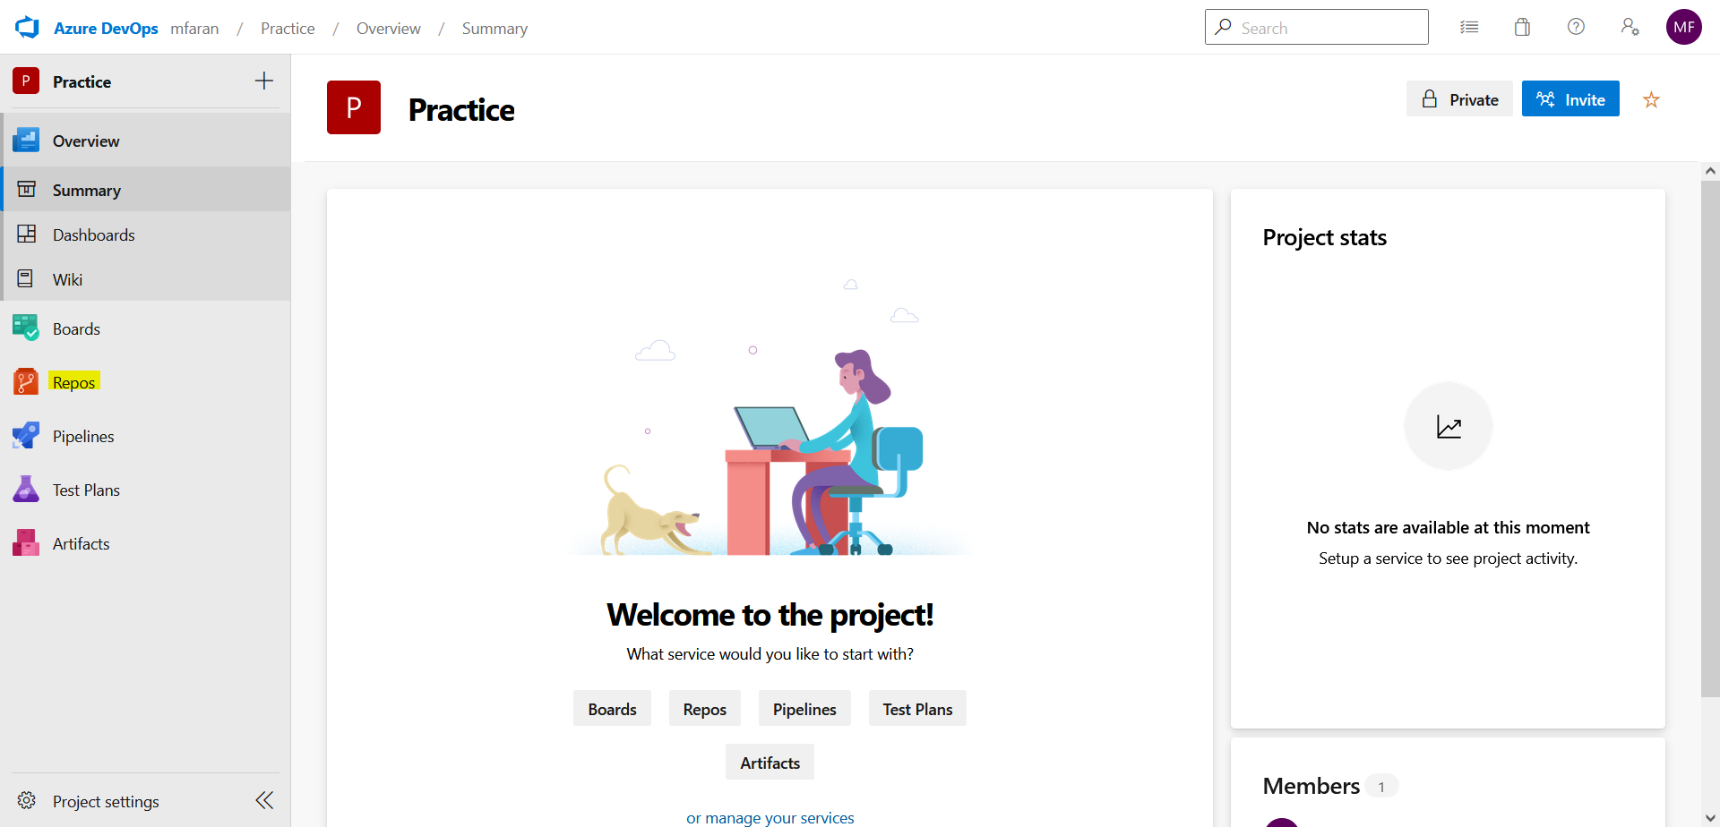
Click on Repo
www.corvit.com

Slide 9
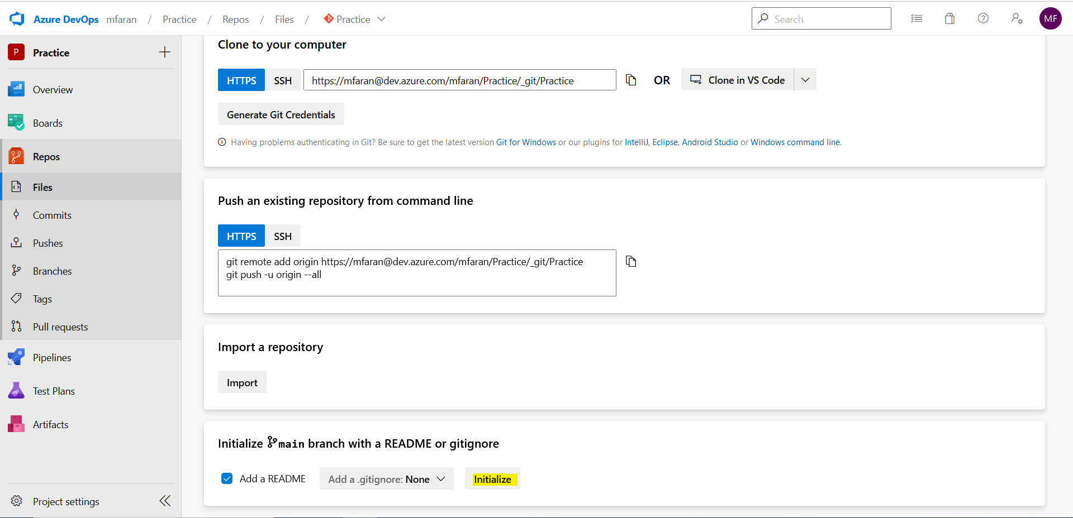
Create new Repo (Click Initialize)
www.corvit.com

Slide 10
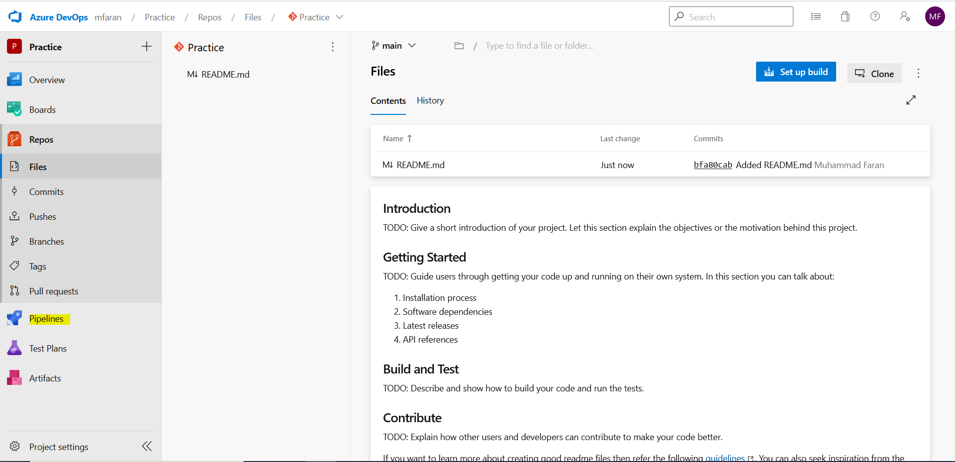
After Repo is created click Pipelines
www.corvit.com

Slide 11
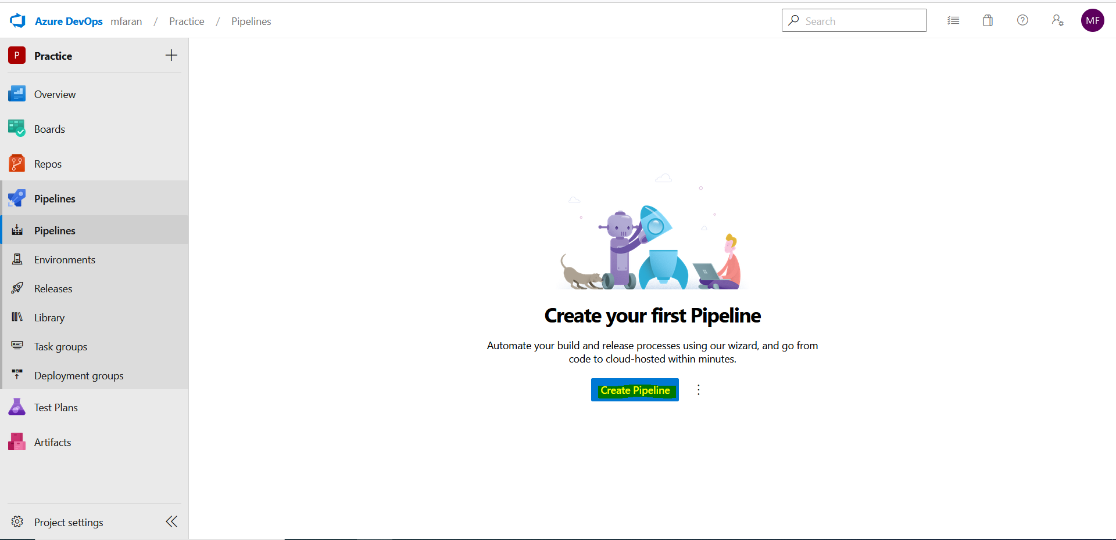
Create New Pipeline
www.corvit.com

Slide 12
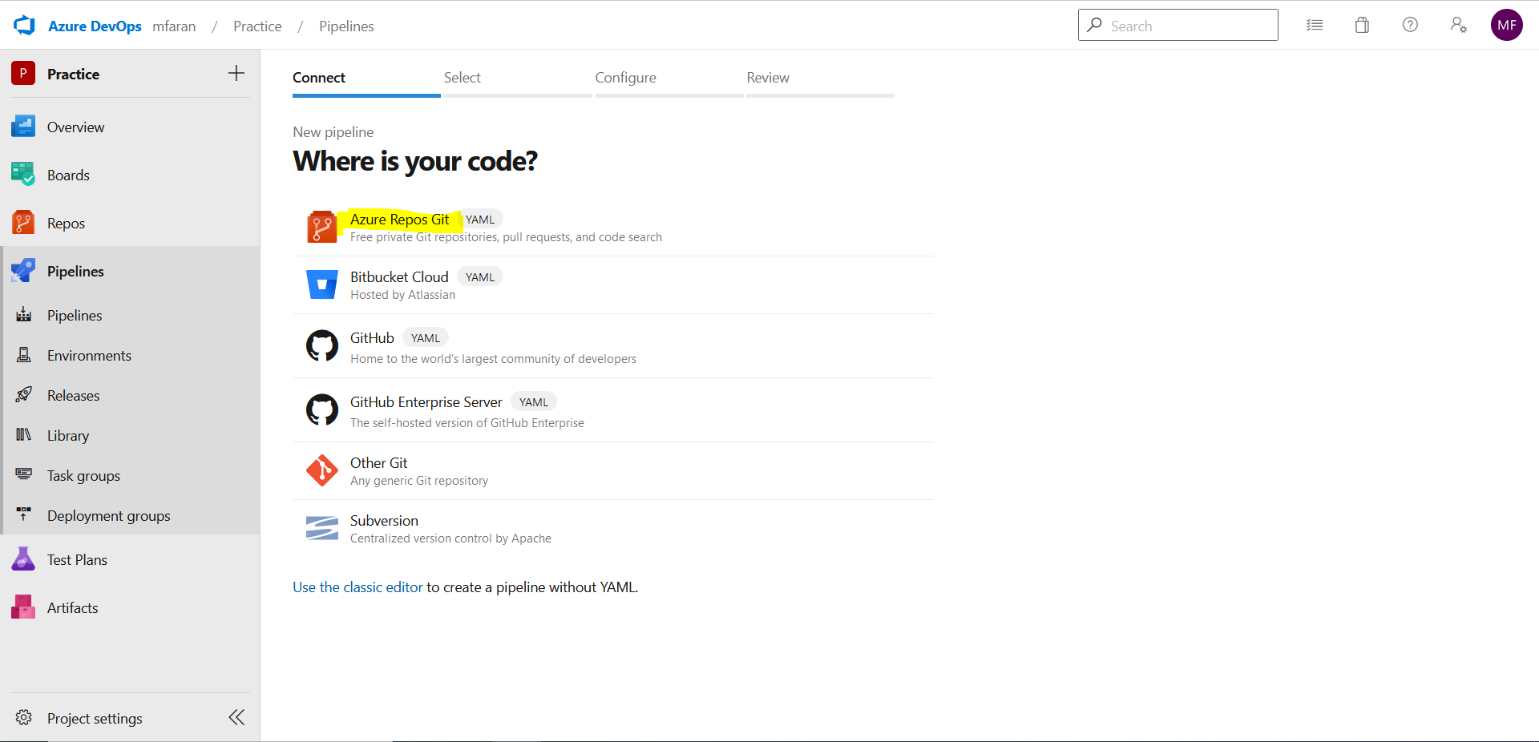
Select Azure Repos Git
www.corvit.com

Slide 13
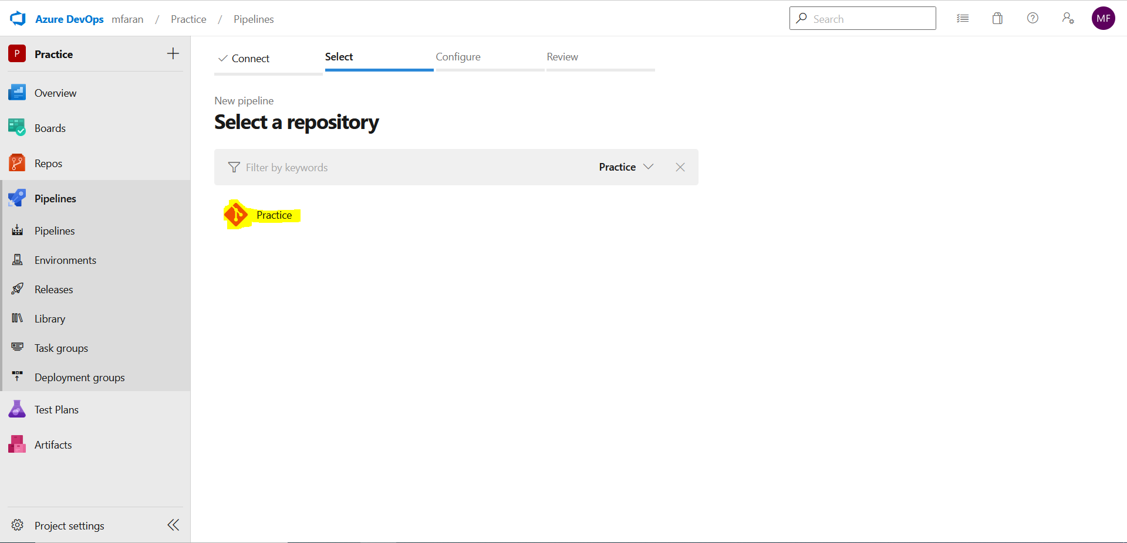
Select Your Repo
www.corvit.com

Slide 14
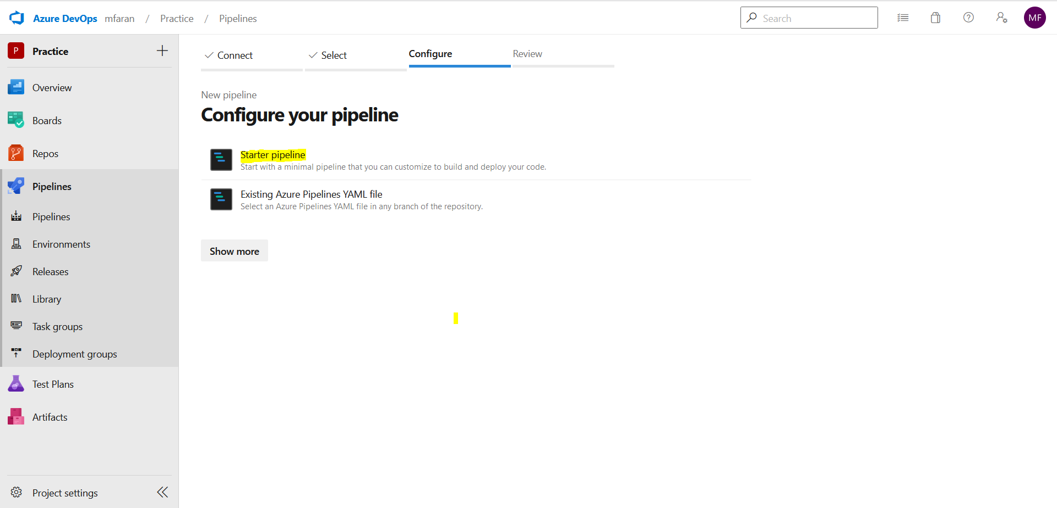
Select Starter Pipeline
www.corvit.com

Slide 15
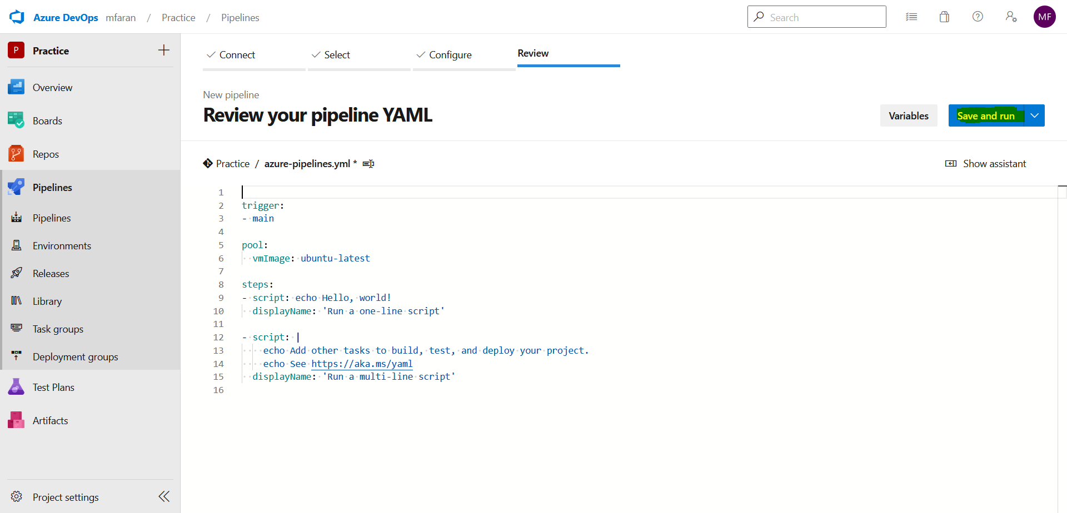
Save and Run
www.corvit.com

Slide 16
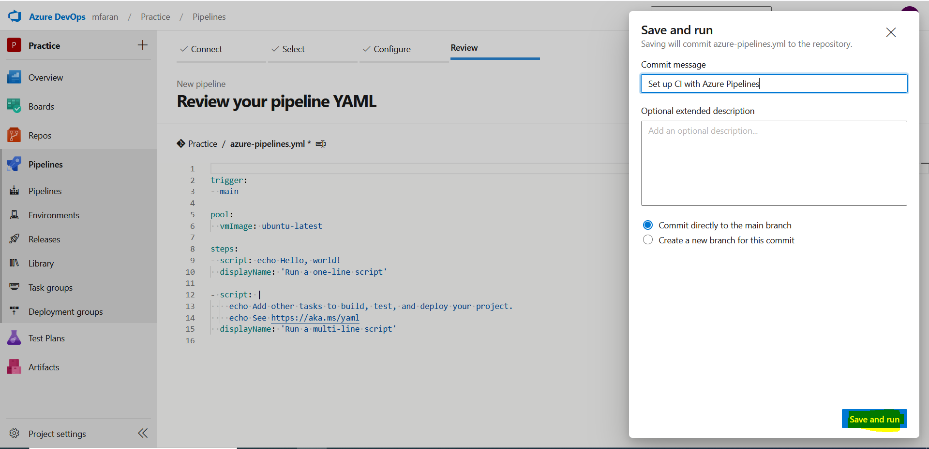
Click Save and Run
www.corvit.com

Slide 17
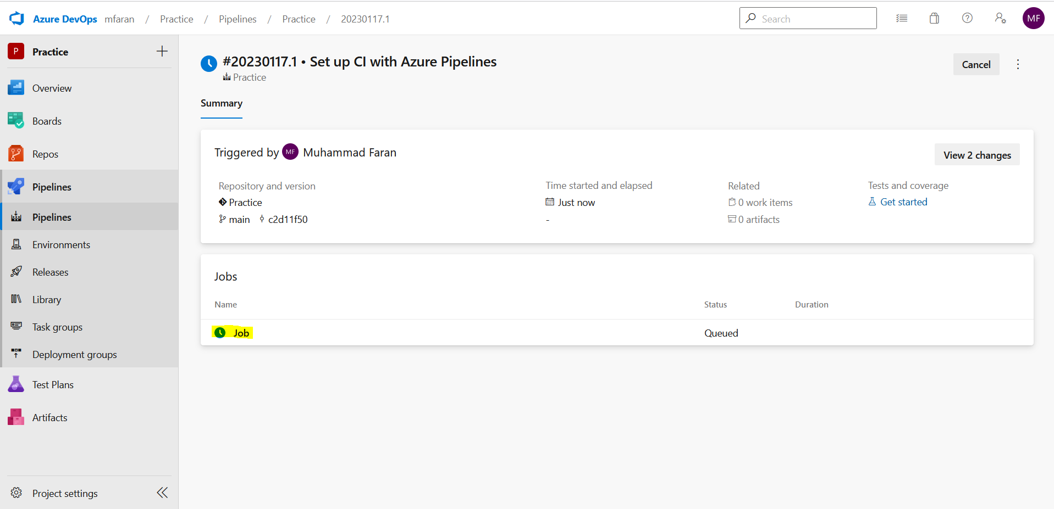
Your pipeline would be created and queued
www.corvit.com

Slide 18
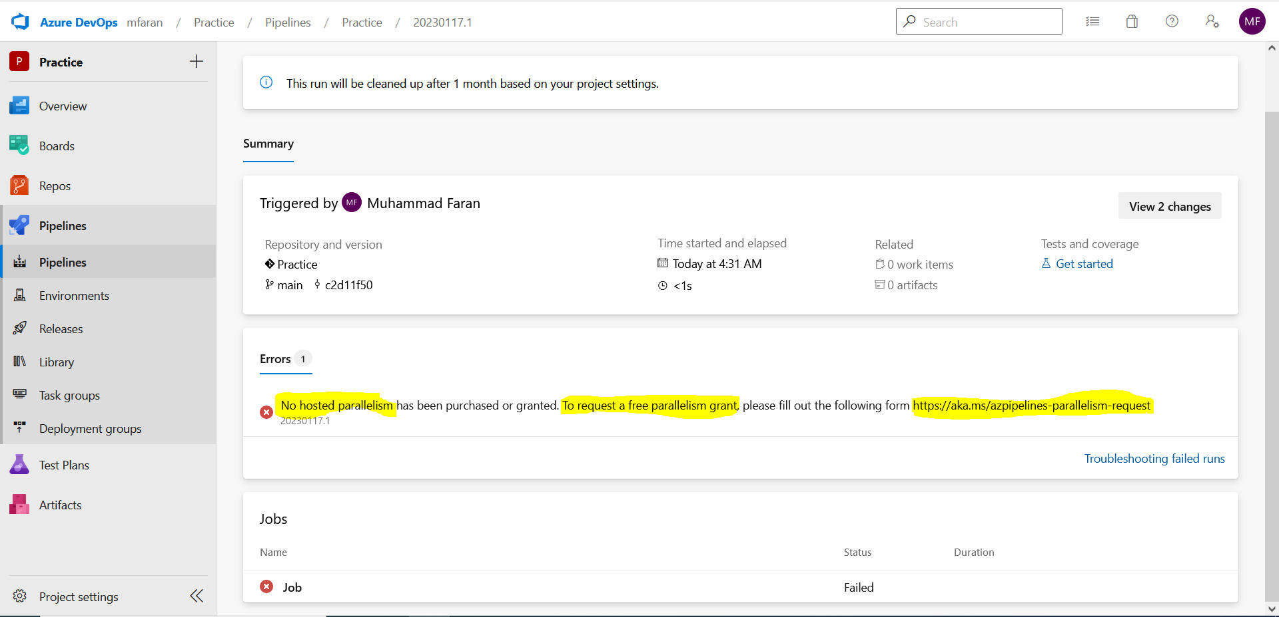
Would face following error
www.corvit.com

Slide 19
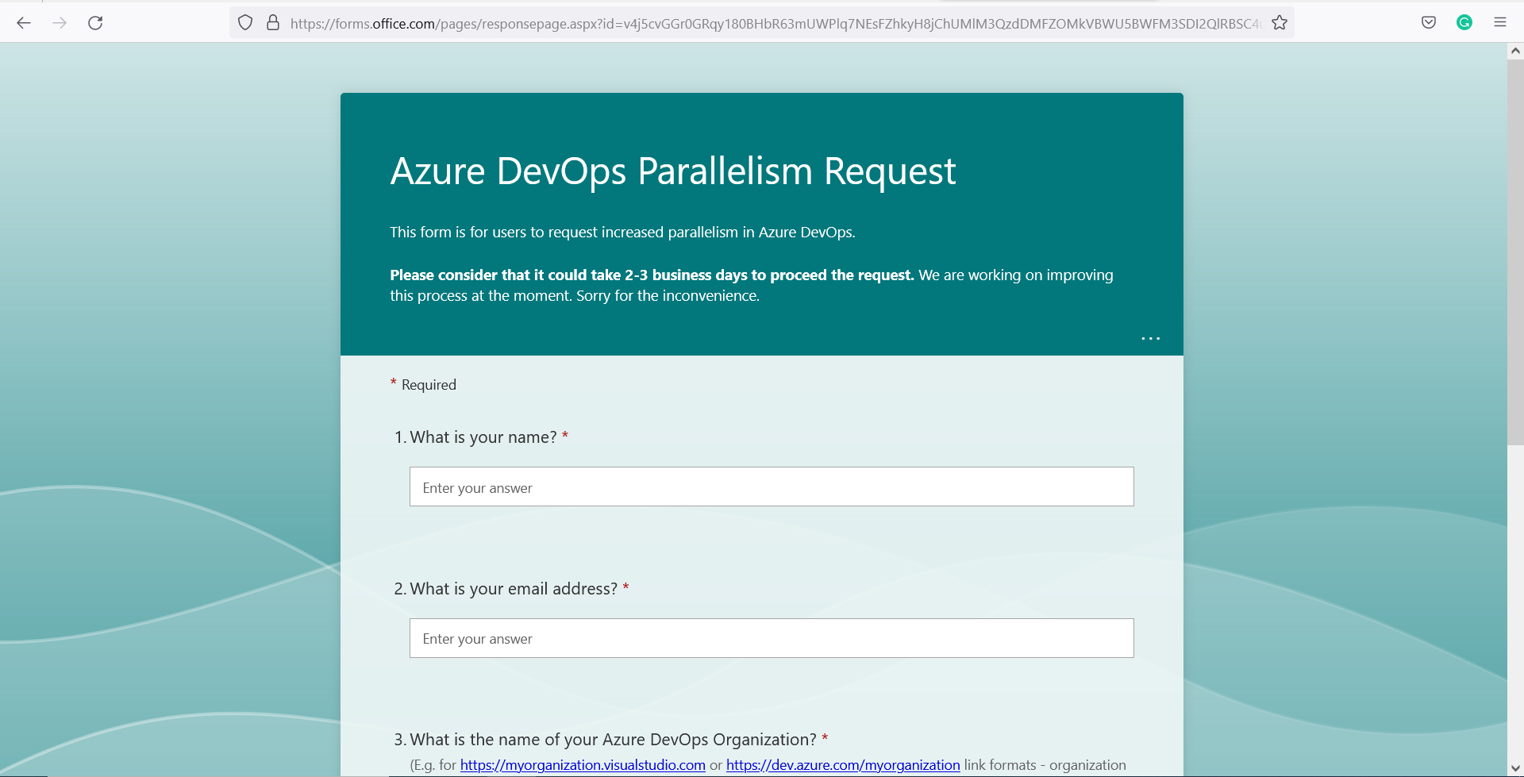
Fill out form to request free agent
www.corvit.com

Slide 20
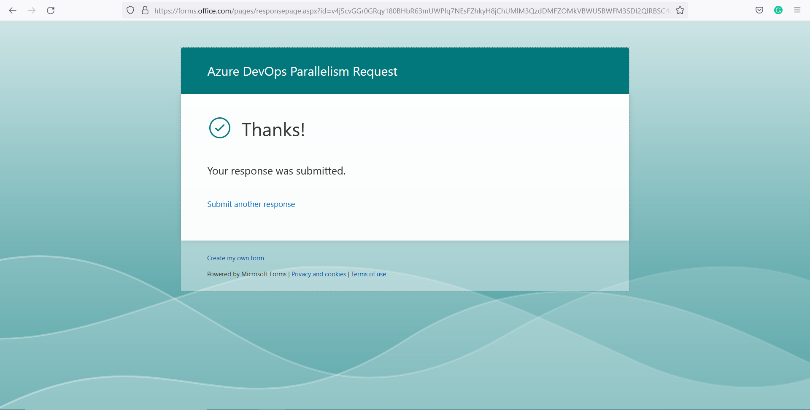
It would take 3 business days
www.corvit.com

Slide 21
Changing Pipeline Name
www.corvit.com

Slide 22
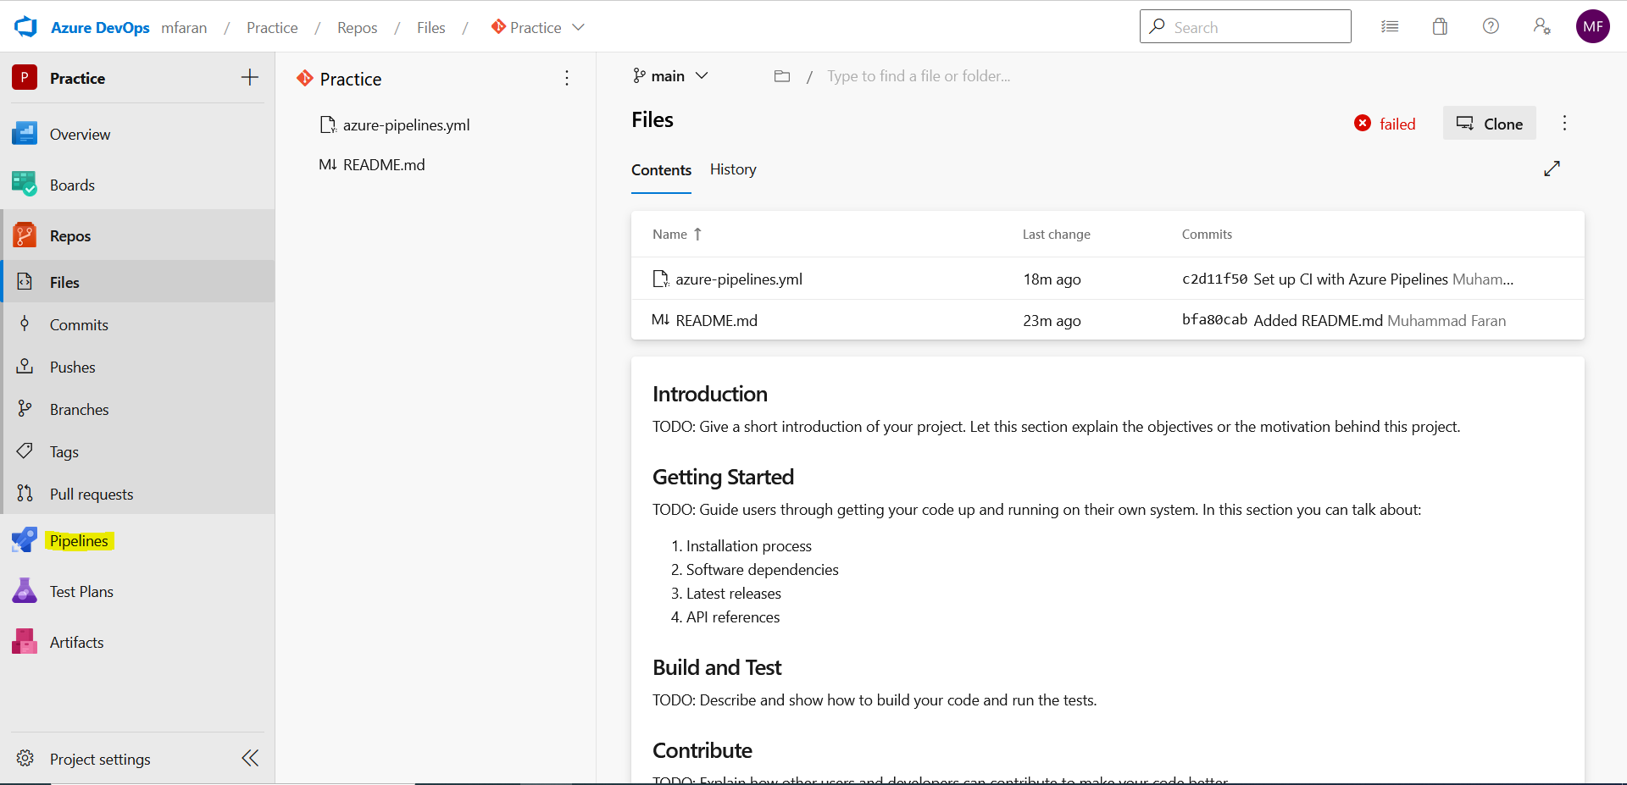
Go to Pipelines
www.corvit.com

Slide 23
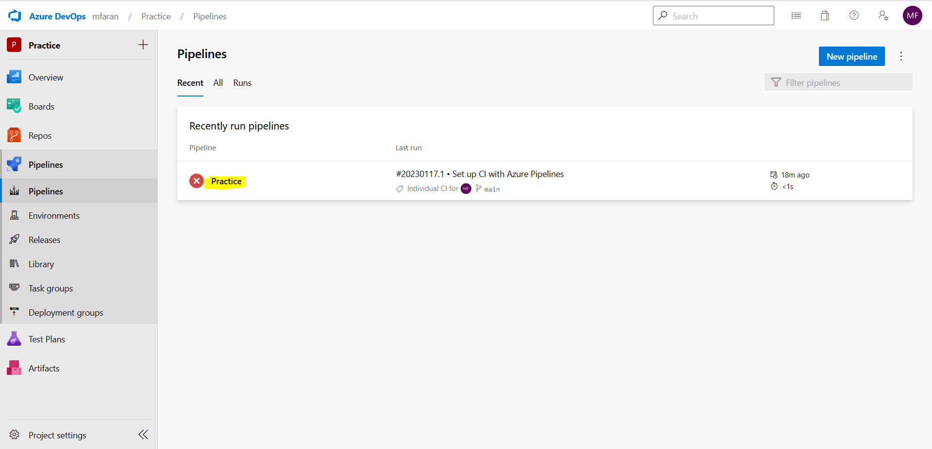
Select your Pipeline
www.corvit.com

Slide 24
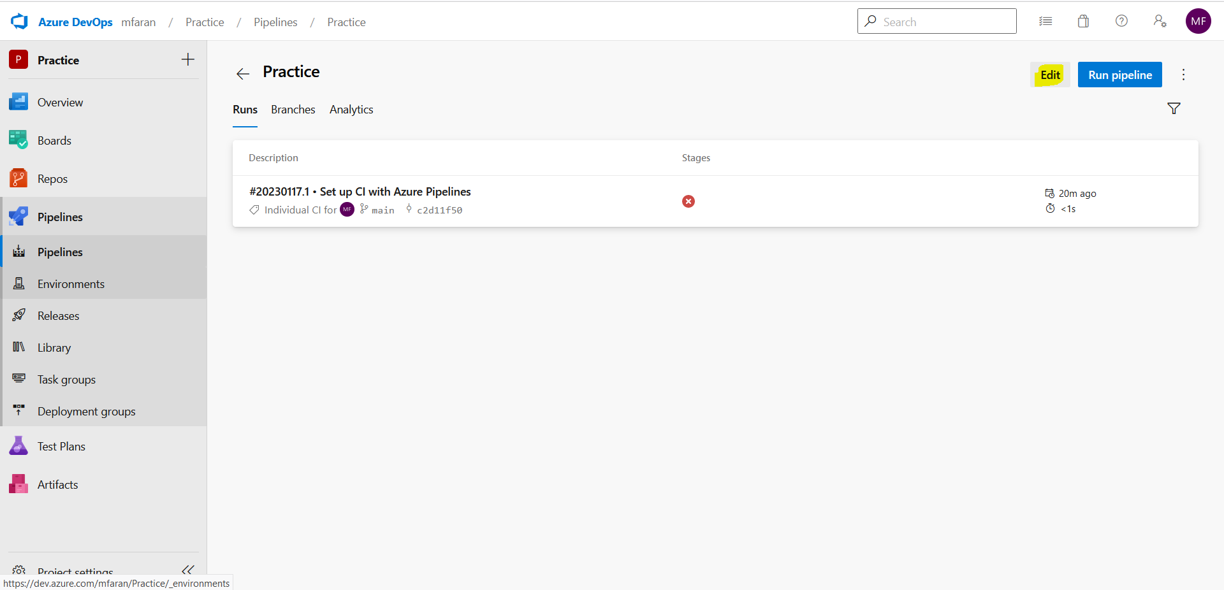
Click on Edit
www.corvit.com

Slide 25
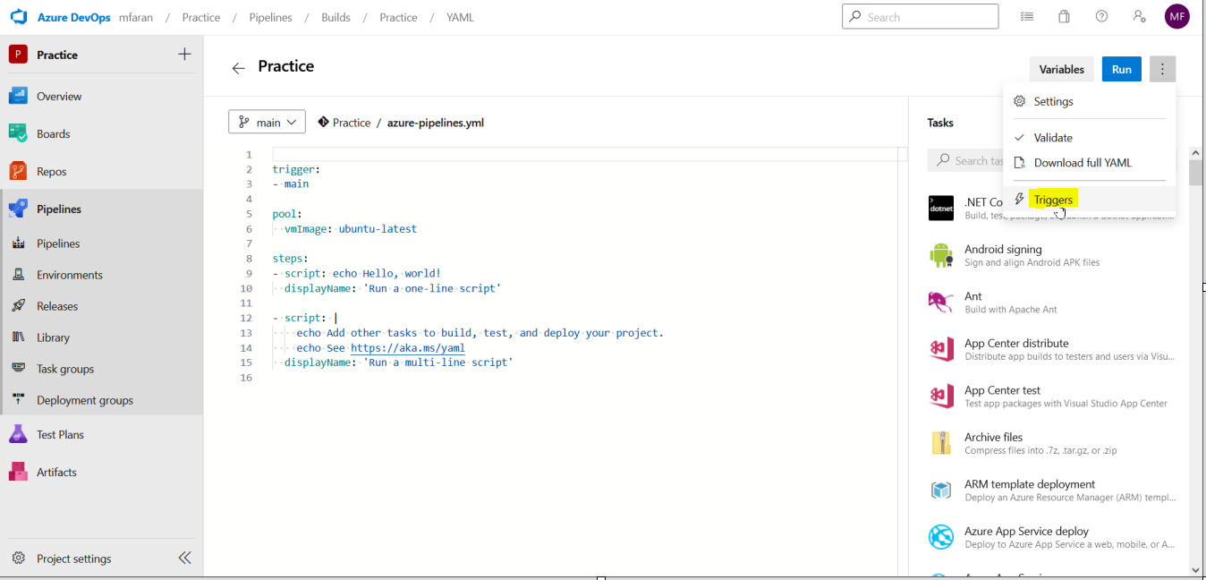
Click on Triggers
www.corvit.com

Slide 26
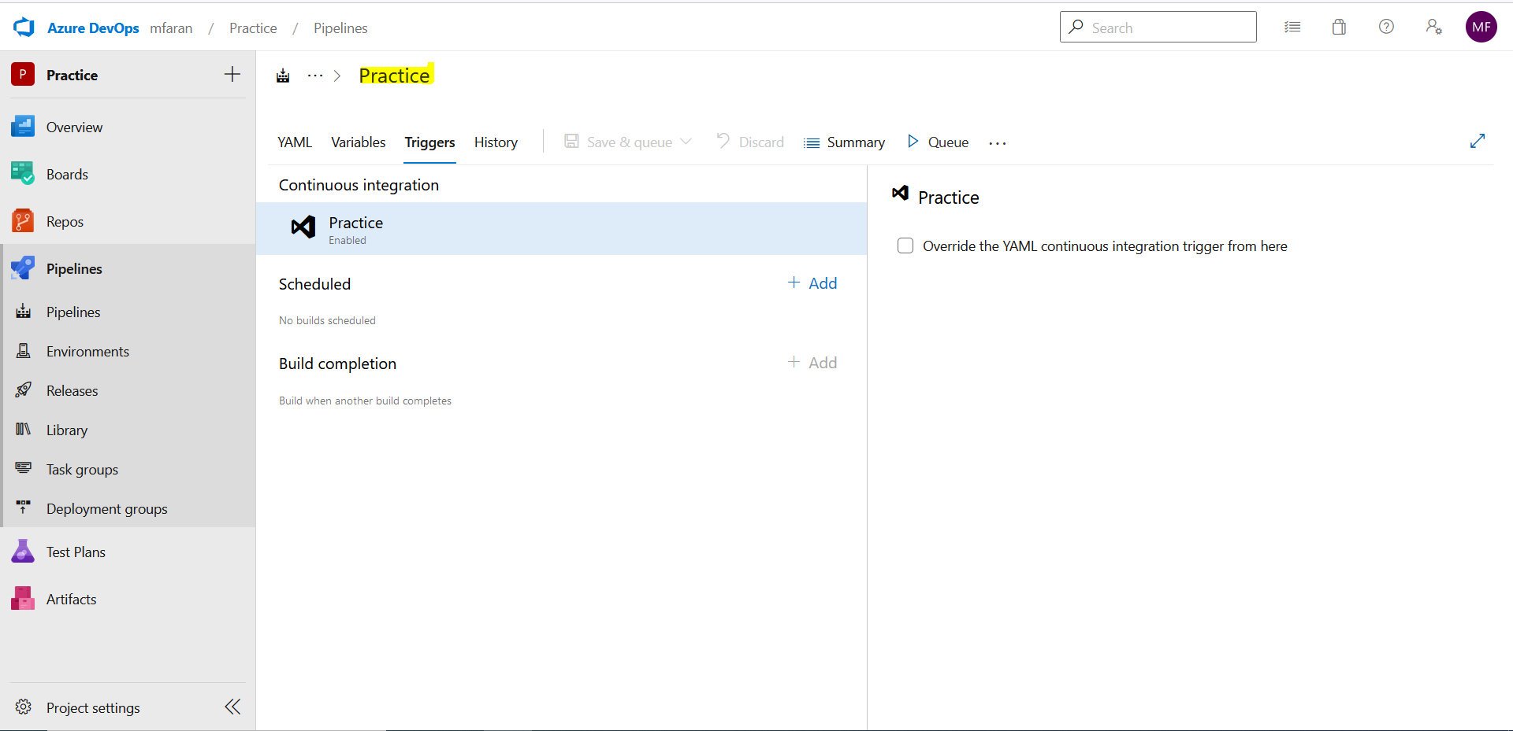
Clear your pipeline name
www.corvit.com

Slide 27
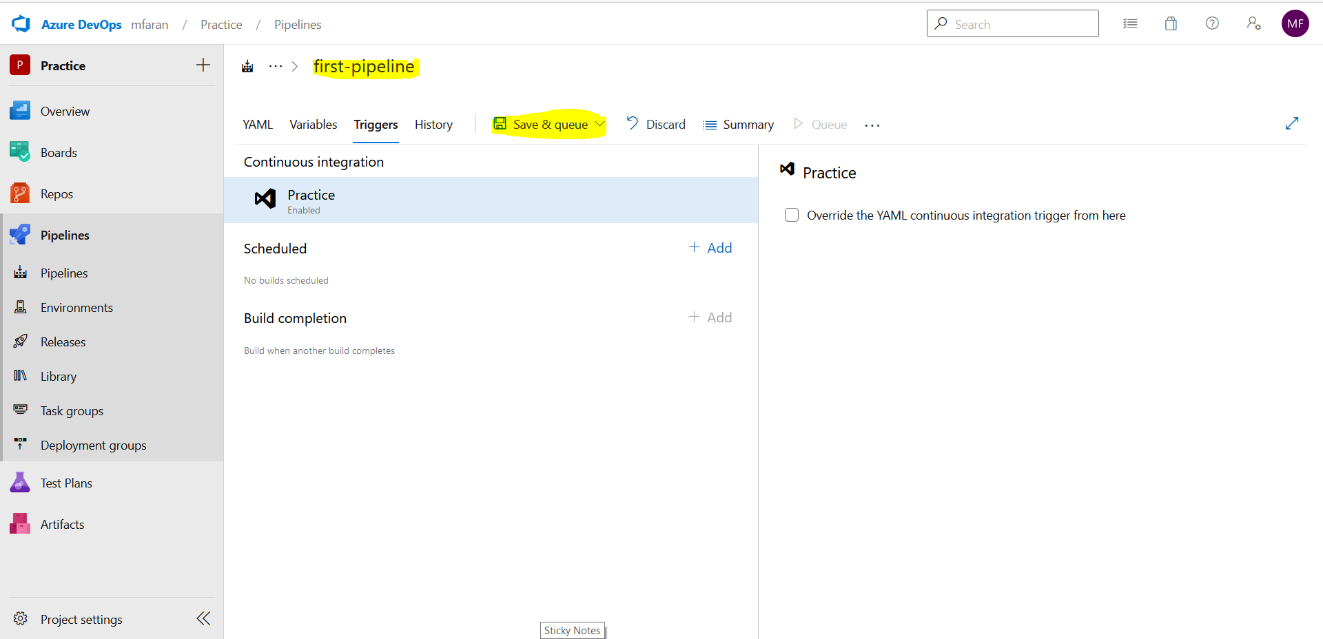
Enter new name
www.corvit.com

Slide 28
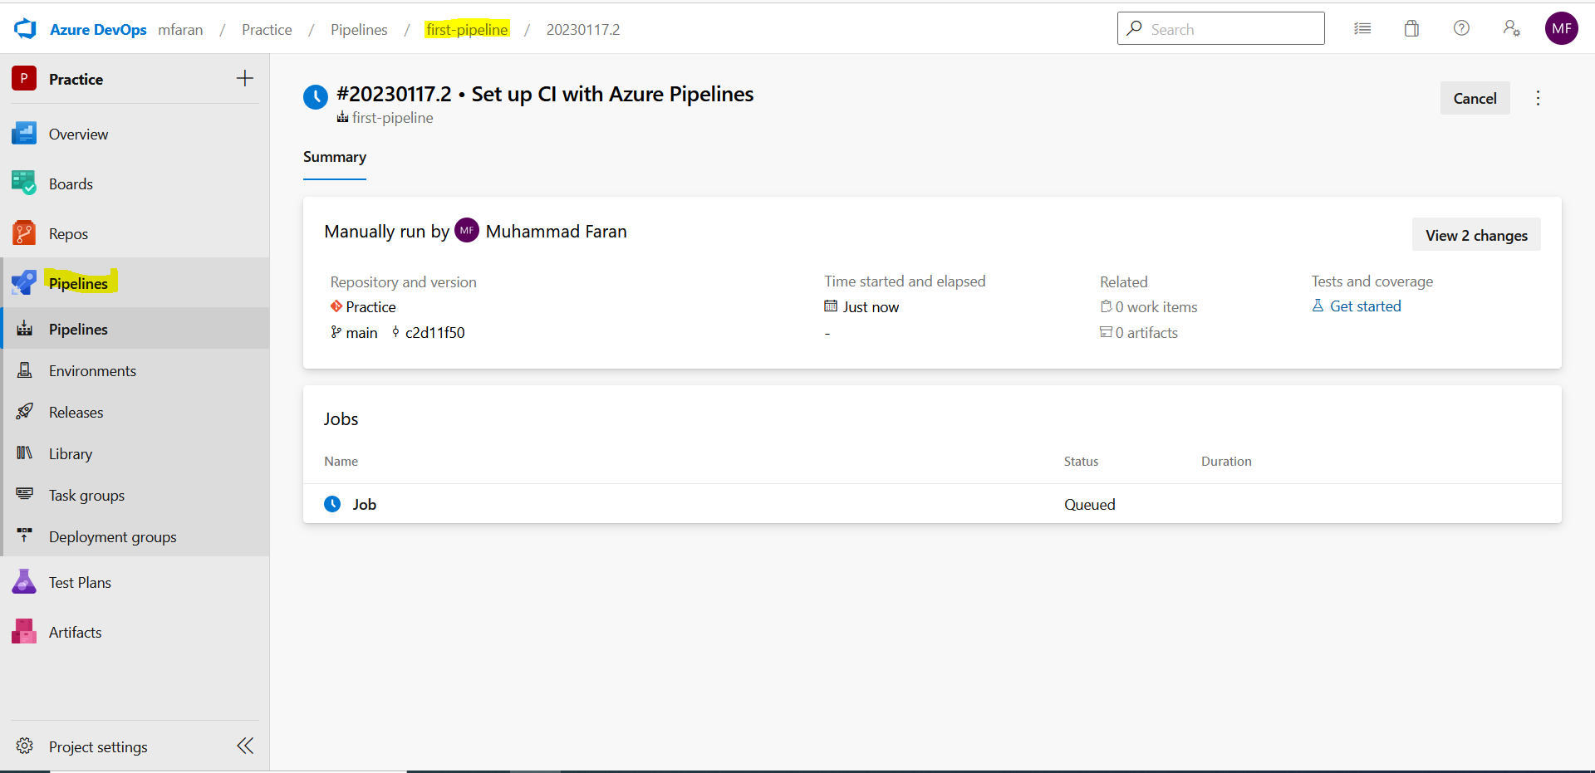
Name Changed
www.corvit.com

Slide 29
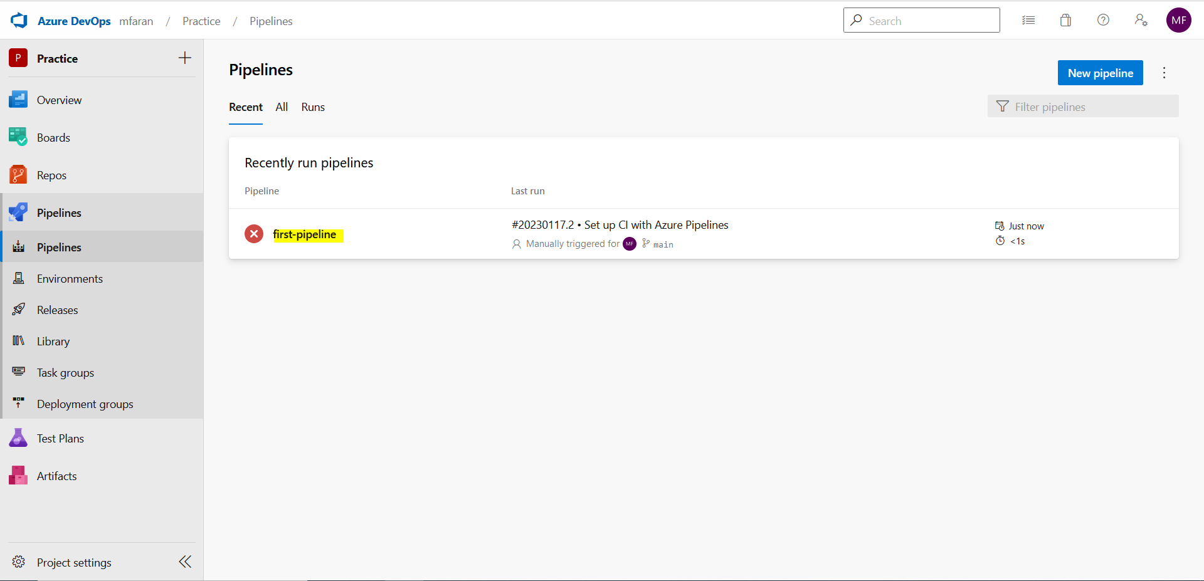
Name Changed
www.corvit.com

Slide 30
Editing Pipeline
www.corvit.com

Slide 31

Go to repo
www.corvit.com

Slide 32
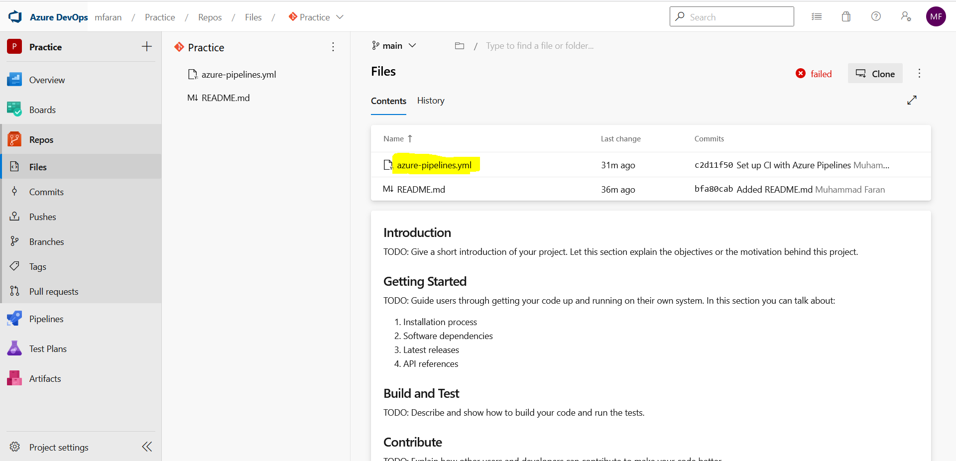
Open Yaml File for pipeline
www.corvit.com

Slide 33
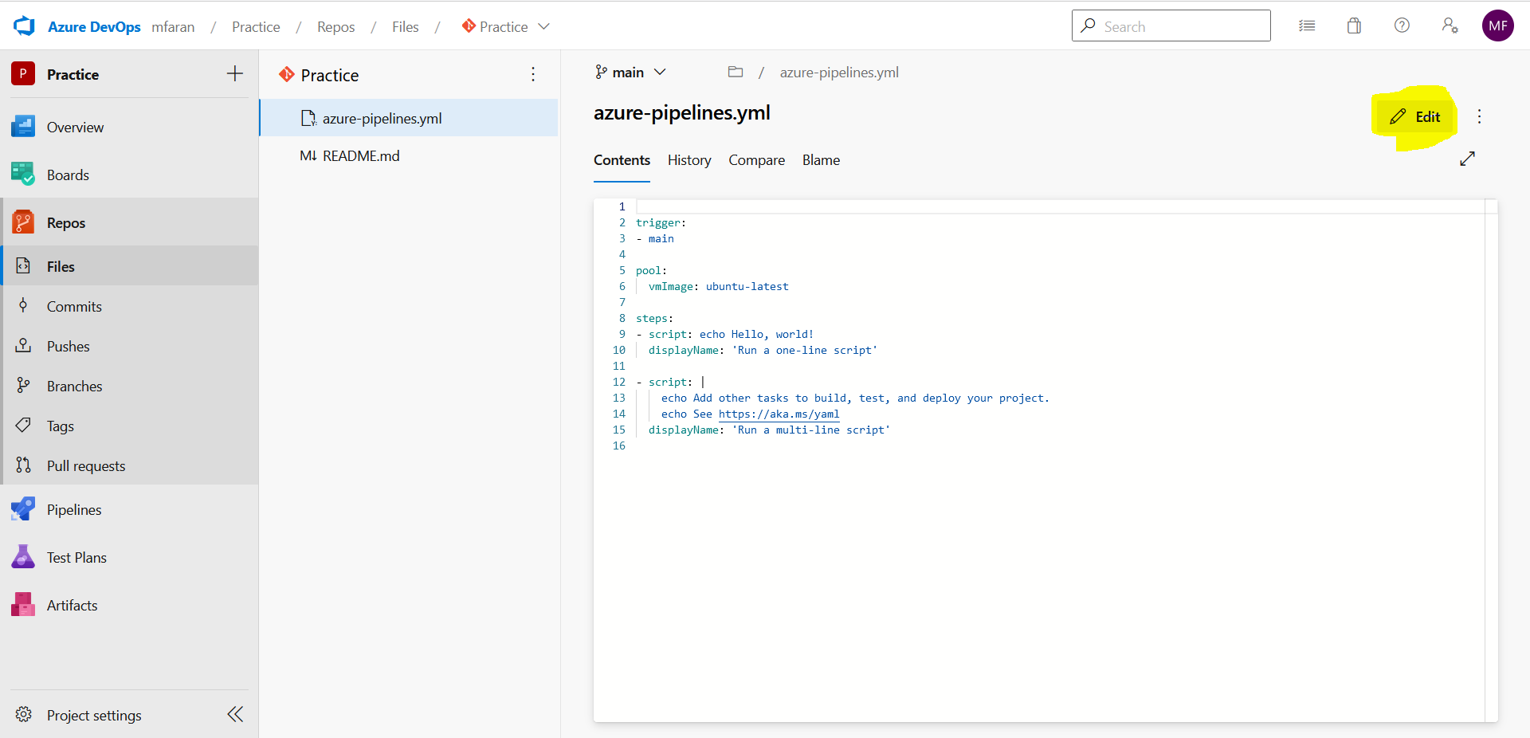
Click Edit
www.corvit.com

Slide 34
Running Pipeline
www.corvit.com

Slide 35
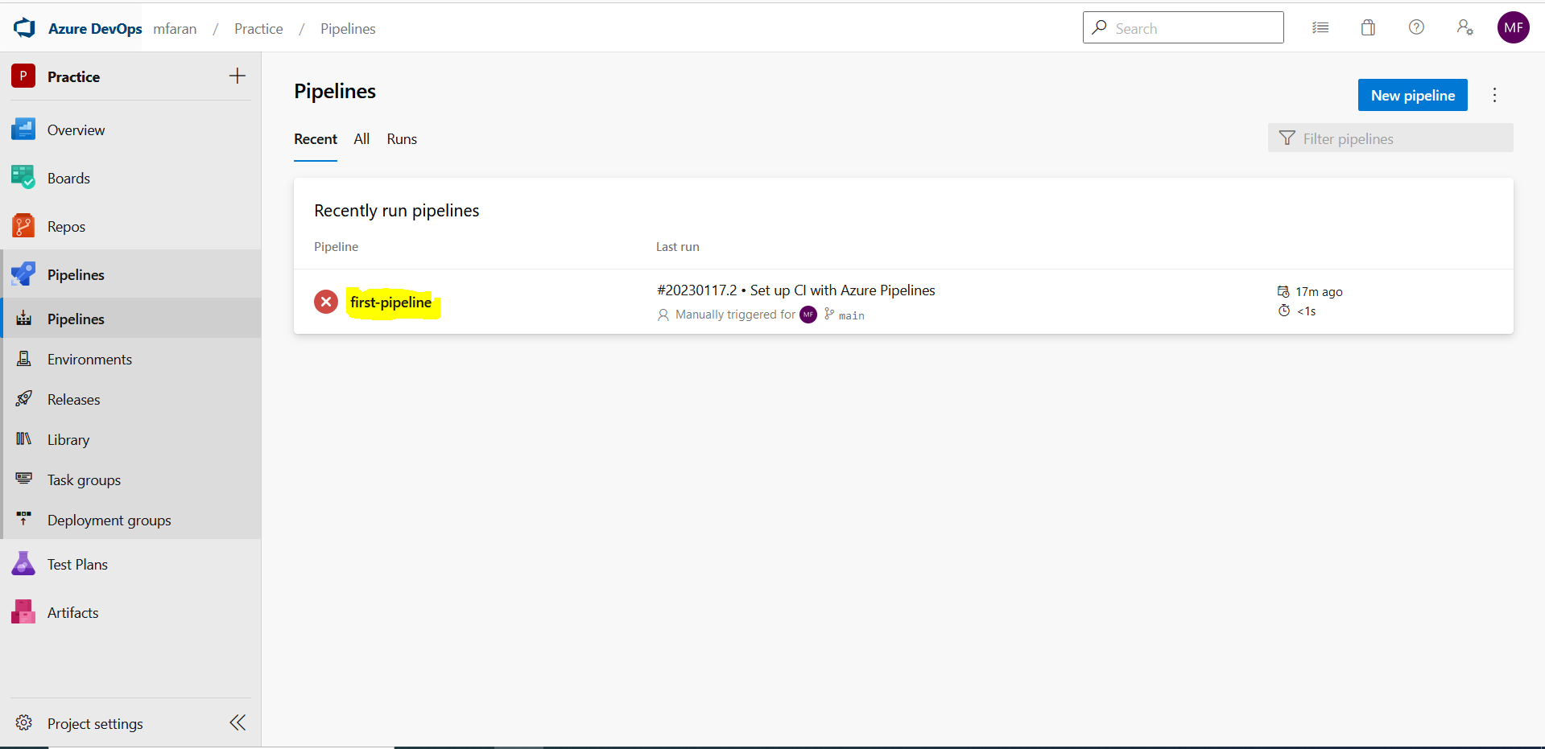
Select Pipeline
www.corvit.com

Slide 36
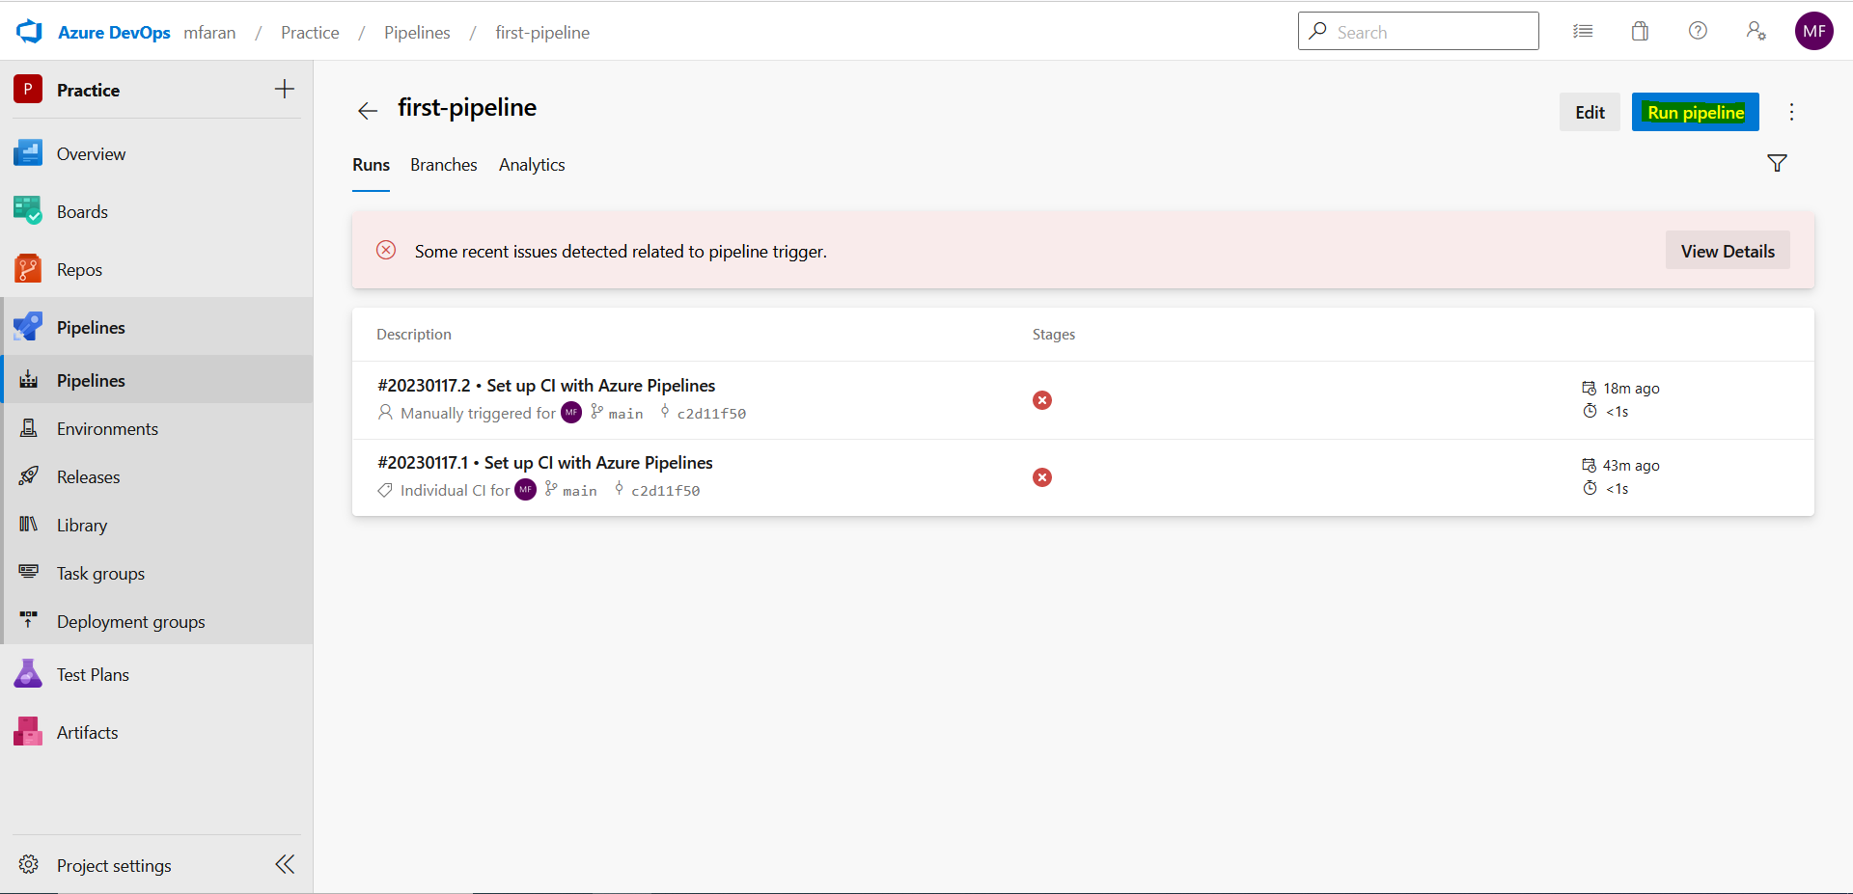
Click on Run Pipeline
www.corvit.com

Slide 37
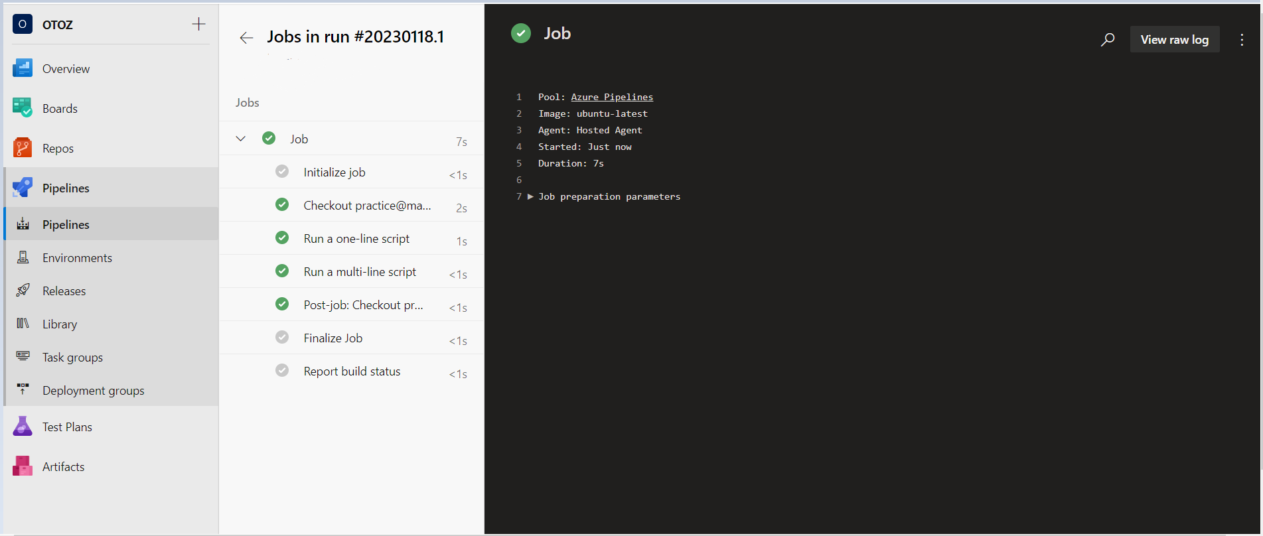
Output
www.corvit.com

Slide 38
Creating Variable Group
www.corvit.com

Slide 39
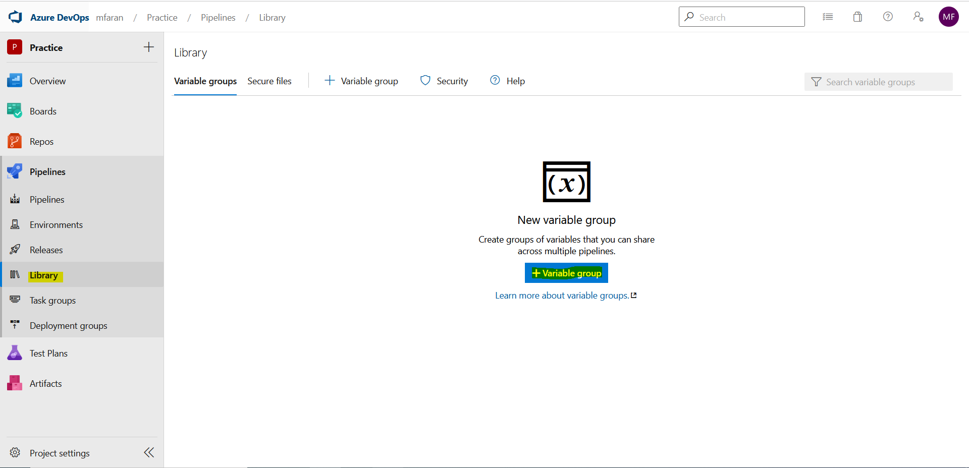
In Pipelines go to Library and add variable group
www.corvit.com

Slide 40
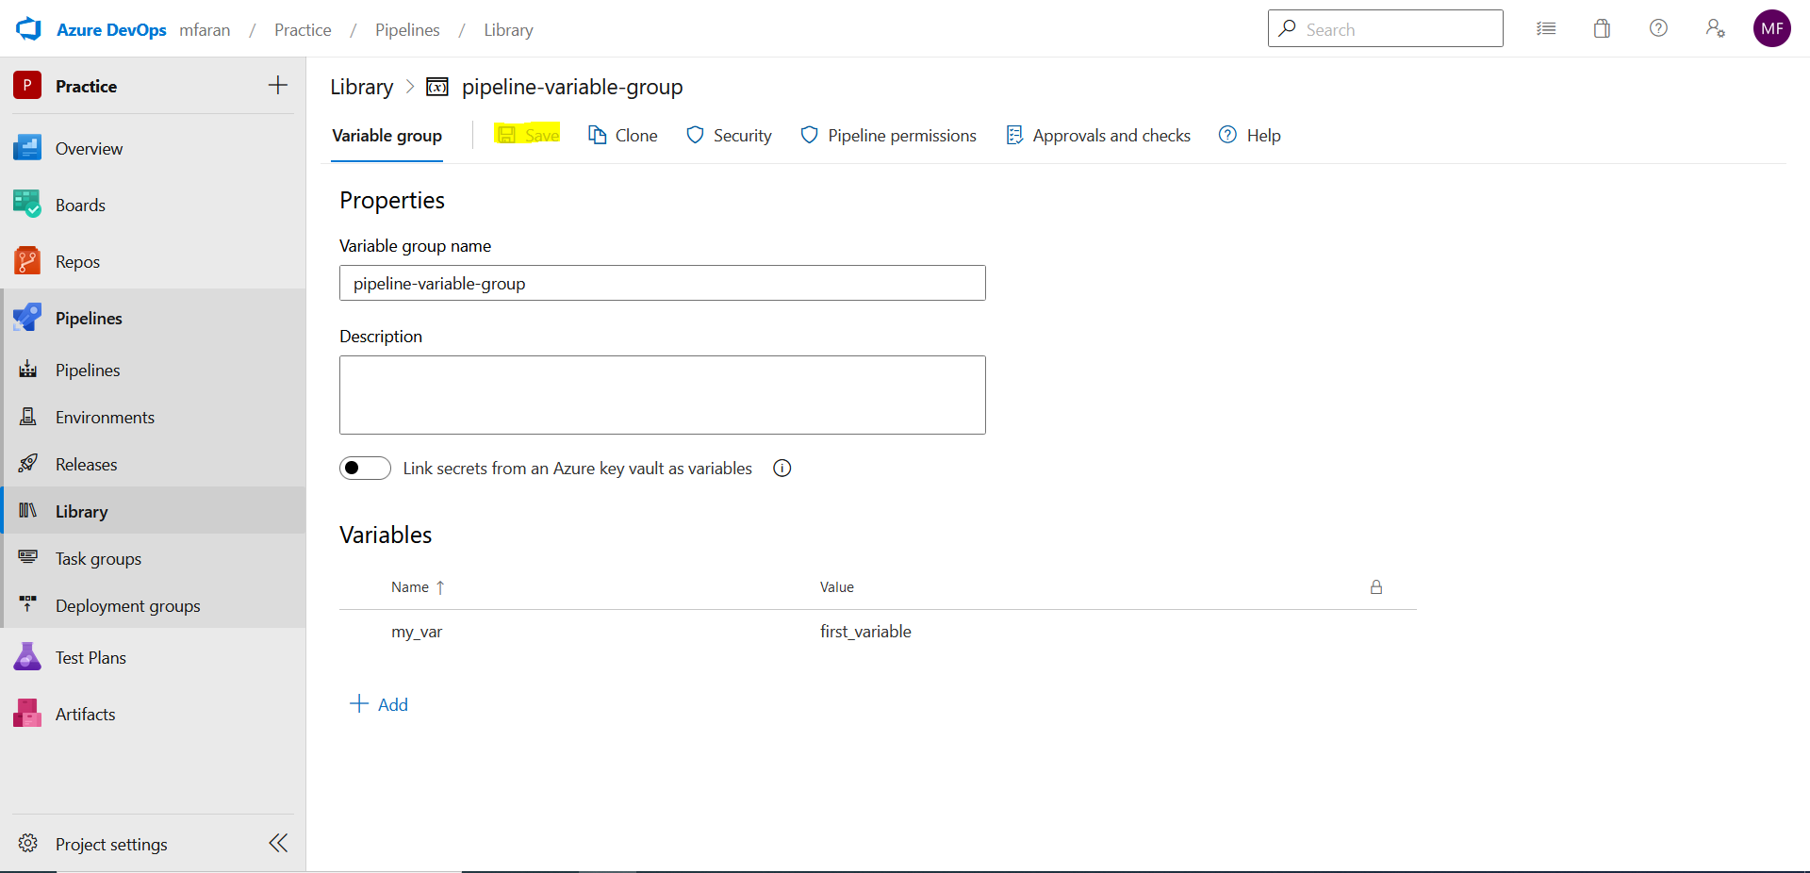
Configure all options and save
www.corvit.com

Slide 41
Attaching Variable Group to Pipeline
www.corvit.com

Slide 42
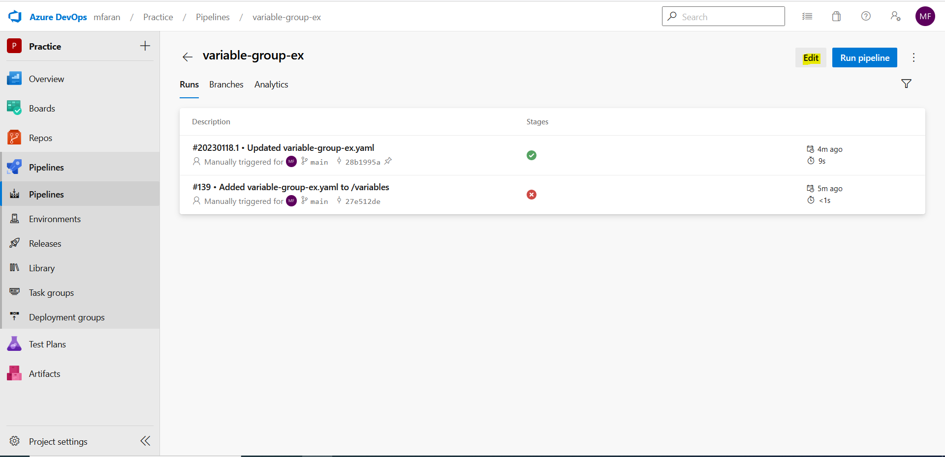
Go to Pipeline and Edit
www.corvit.com

Slide 43
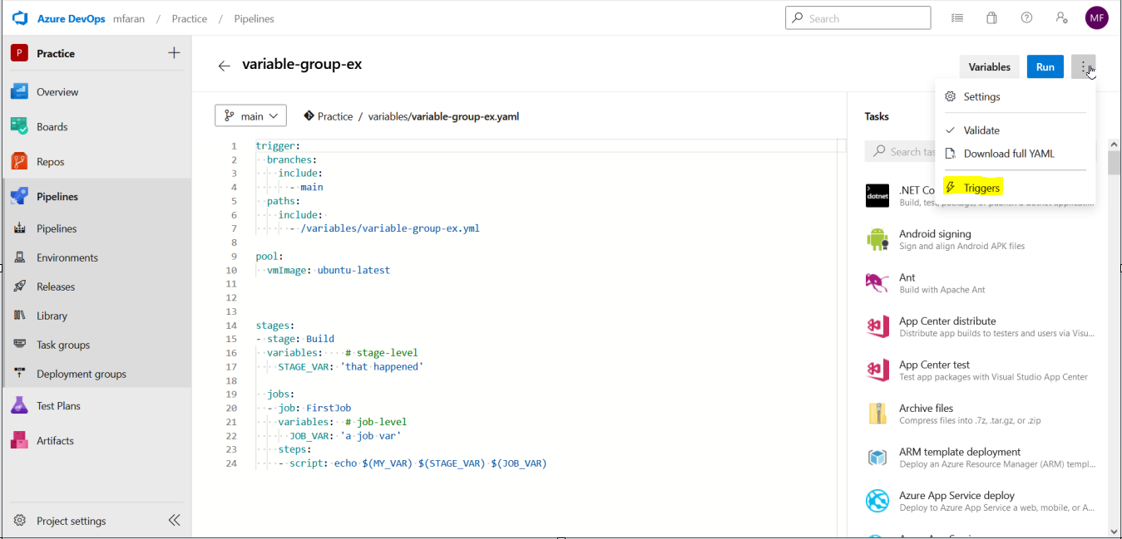
Select Triggers
www.corvit.com

Slide 44
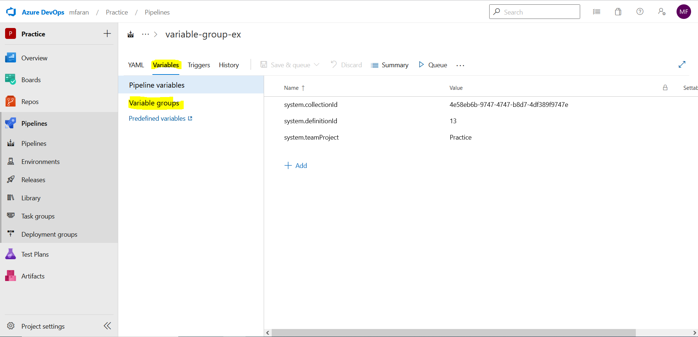
In Variables tab select variable groups
www.corvit.com

Slide 45
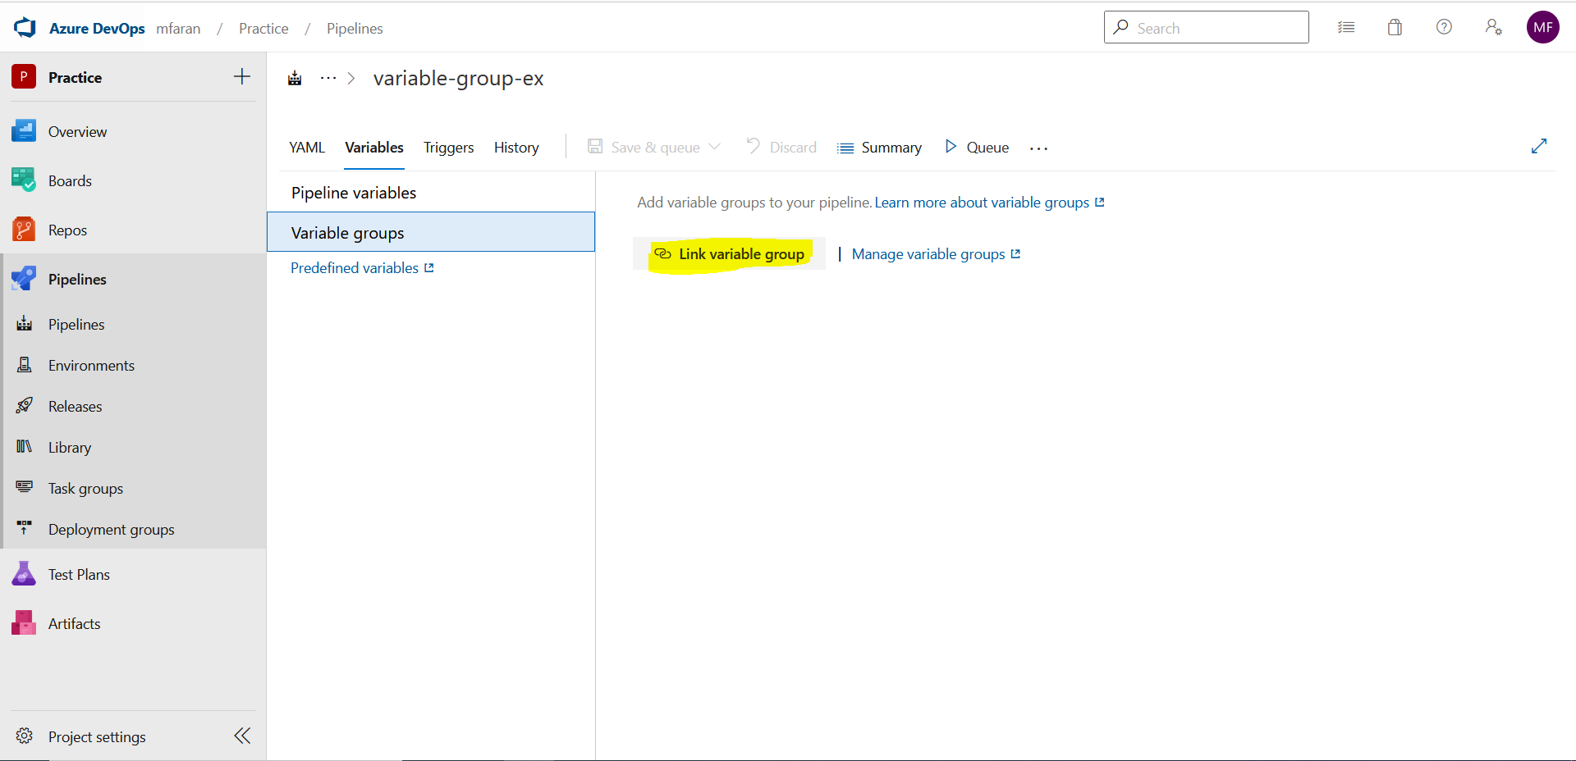
Select link variable group option
www.corvit.com

Slide 46
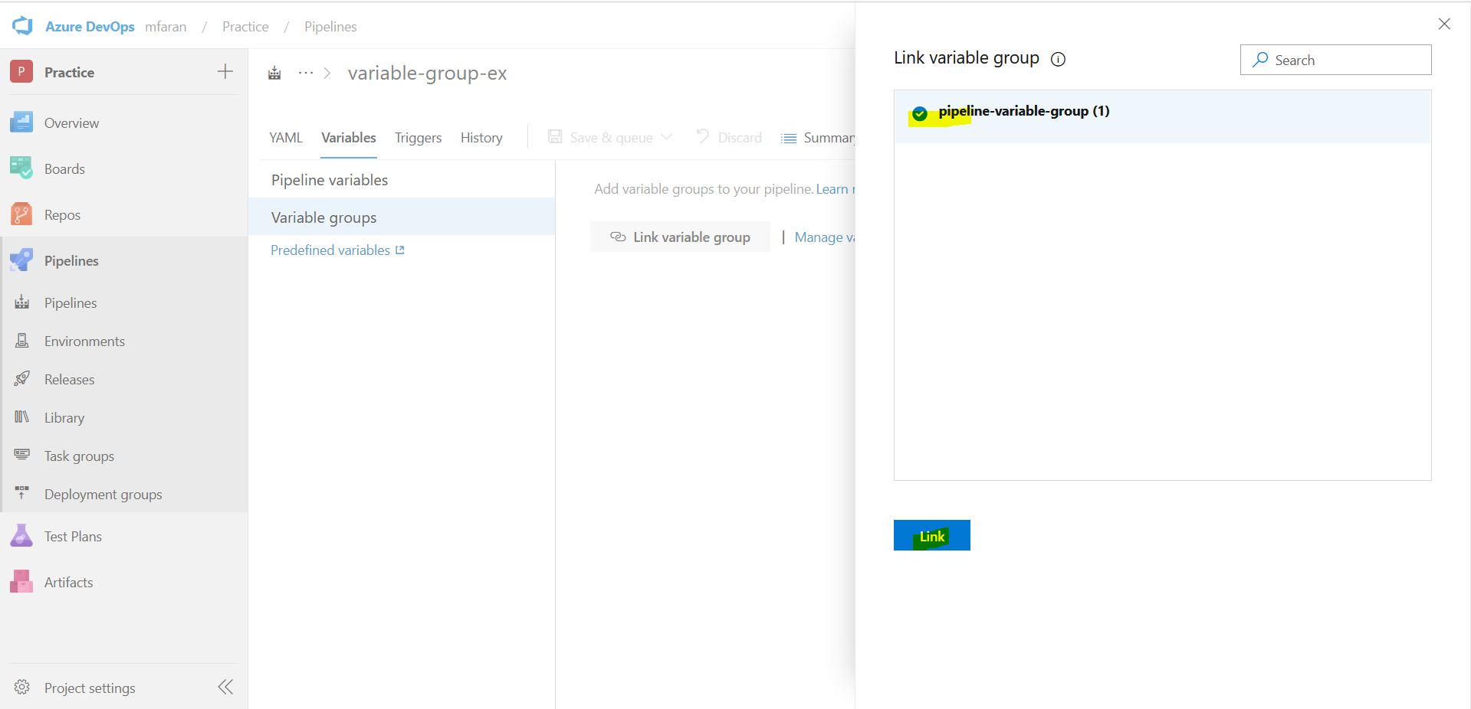
Select the group and click link
www.corvit.com

Slide 47
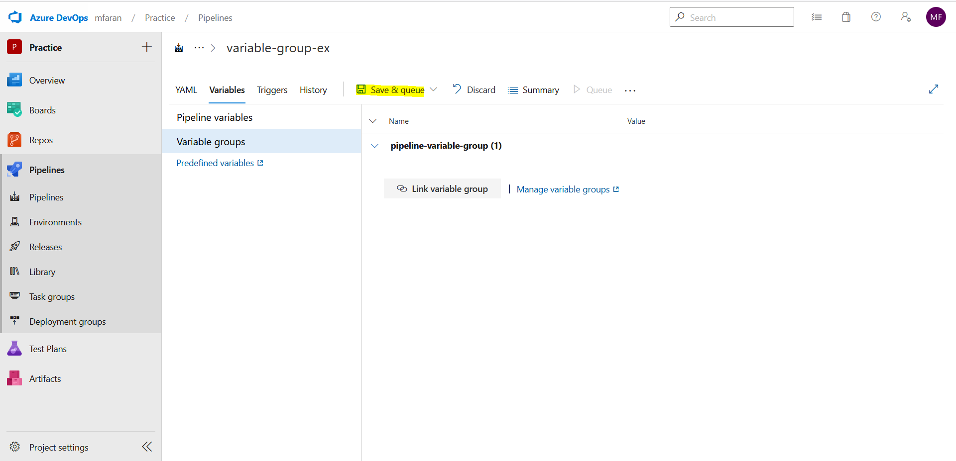
Save the settings
www.corvit.com

Slide 48
Expressions in Azure DevOps YAML
and:
and(
eq(parameters.version, '1.0'), eq(parameters.version, '2.0')
)
or:
or(
eq(parameters.version, '1.0'), eq(parameters.version, '2.0')
)
ne:
ne(parameters.version, '1.0')
eq:
eq(variables.version, '1.0')
contains:
contains(variables.version, '1')
startsWith:
startsWith(variables.version, '1')
endsWith:
endsWith(variables.version, '.2')
ge (Greater Than or Equal To):
ge(variables.version, 1)
gt (Greater Than):
gt(variables.version, 1)
le (Less Than or Equal To):
le(variables.version, 2)
lt (Less Than):
lt(variables.version, 2)
www.corvit.com
Notes:
https://thomasthornton.cloud/2022/05/03/if-elseif-or-else-in-azure-devops-pipelines/

